Slide 1
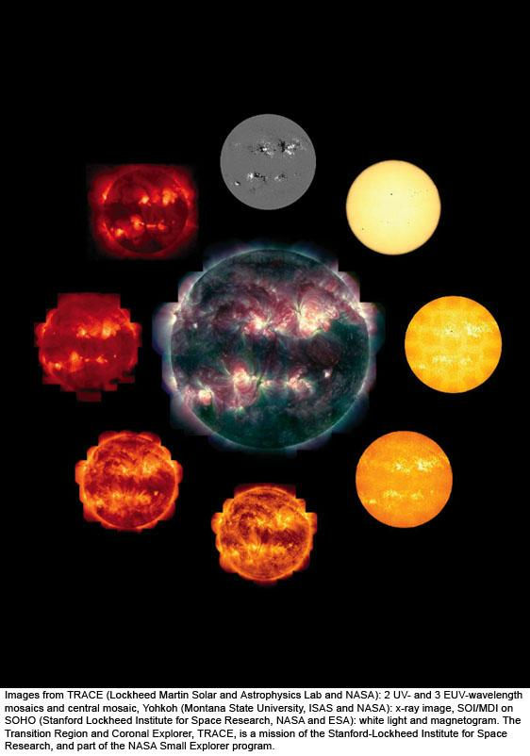
a
© Gerard Williger 2023 U Louisville
Lec 5: The Sun
Mag fields SOHO
Optical SOHO
X-ray
Yohkoh
Mass: 330,000x Earth
Diameter: 110x Earth
Average Density: 1.4 g/cc (little more than water)
TRACE FeIX 171Ǻ
TRACE UV
UV
TRACE UV
TRACE FeXII 195 Ǻ
TRACE FeXV 284 Ǻ
Notes:
The Sun in various wavelengths. The central image is a composite of 3 ultraviolet wavelengths, high-resolution images from the Transition Region and Coronal Explorer (TRACE) spacecraft. The filters used show us only the hottest gas, at millions of degrees. We clearly see how the coronal gas is shaped into loops, which are kept in that form by magnetic fields. The smaller images are, clockwise from the top, a magnetic map, a visible-light image, five individual images with different TRACE filters, and an x-ray image.
Images from TRACE (Lockheed Martin Solar and Astrophysics Lab and NASA): 2 UV- and 3 EUV-wavelength mosaics and central mosaic, Yohkoh (Montana State University, ISAS and NASA): x-ray image, SOI/MDI on SOHO (Stanford Lockheed Institute for Space Research, NASA and ESA): white light and magnetogram. The Transition Region and Coronal Explorer, TRACE, is a mission of the Stanford-Lockheed Institute for Space Research, and part of the NASA Small Explorer program.

Slide 2
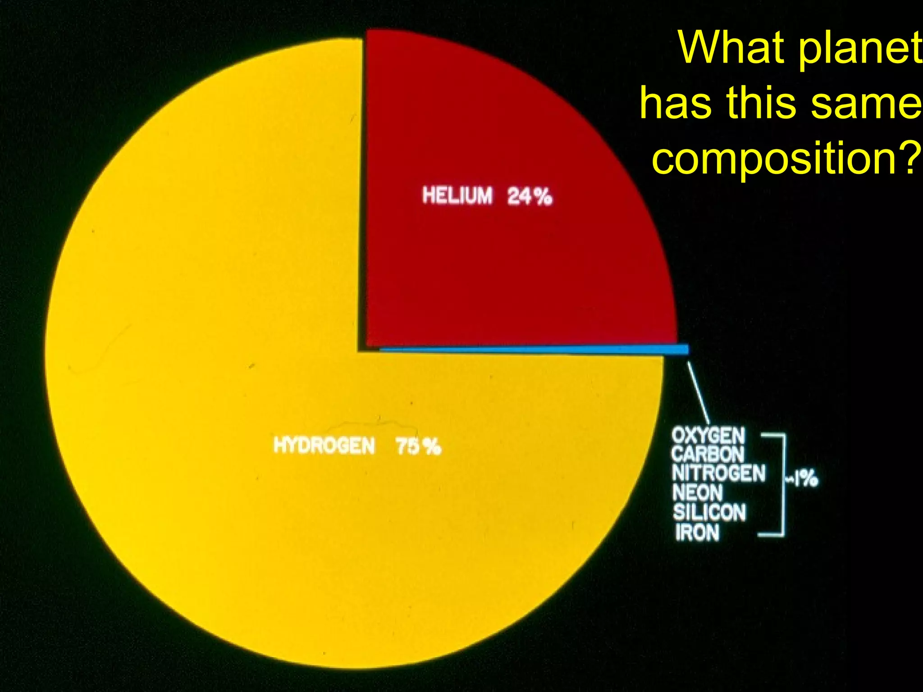
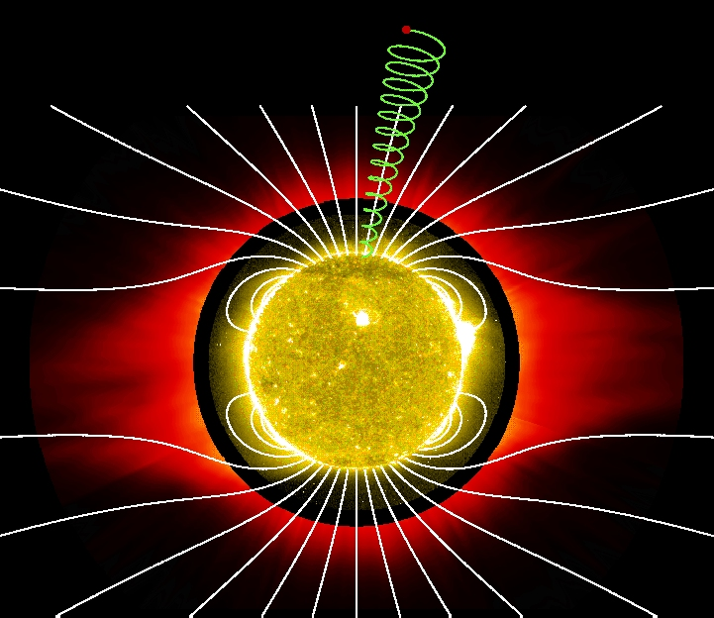
Overview of Sun
© Gerard Williger 2023 U Louisville
Mid-size/mass between smallest, largest stars, 4.5-5.8 Gyr old
Photosphere (“light disk”) T=5800K = 10,000F, midway between coolest, hottest stars
But MOST stars are smaller and cooler
92% hydrogen, 7.8% helium, 0.2% everything else (by numbers of atoms)
Has magnetic fields all over → control activity
Sun’s compo-sition

Slide 3
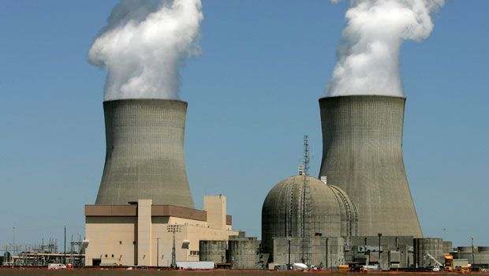

Sun’s Luminosity
© Gerard Williger 2023 U Louisville
L_{sun}=3.9x10²⁶ Watts (Joules/sec)
Earth’s worldwide power consumption/sec 2022: 6.7 Terawatts (6.7x10¹² W) (Wikipedia)
1 second of Sun’s luminosity could power civilization for 1.8 million yrs (if 100% efficient)

Slide 4
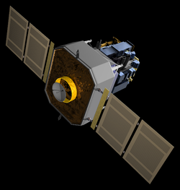
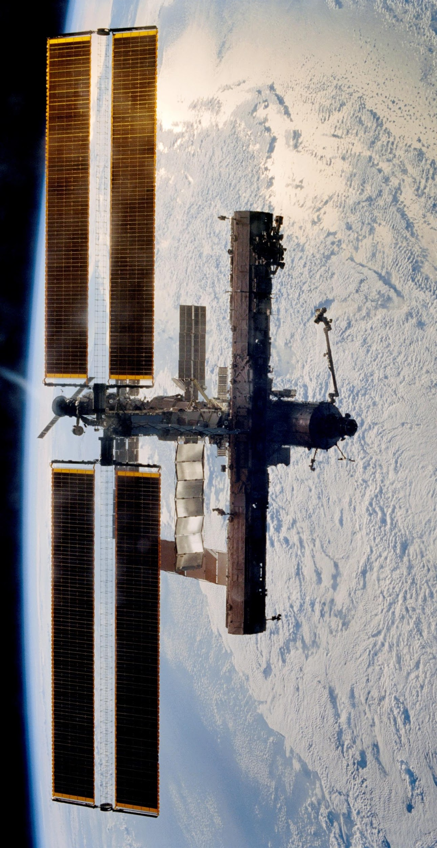
Some Satellites Studying Sun
SOHO (Solar & Heliospheric Observatory): NASA+ESA (1995-)
Hinode (`sunrise’): Japan/NASA/British (2006-), images to 175km resolution in UV to study corona and flares
STEREO A,B (Solar Terrestrial Relations Observatory): NASA (2006-)
Solar Monitoring Observatory (on Int’l Space Station): NASA (2008-)
Solar Dynamic Observatory: NASA (2011-)
Parker Solar Probe: NASA (2018-), to 10 solar radii
HiSolar Orbiter (SolO) : ESA (2020-), study solar poles from 60 solar radii
© Gerard Williger 2023 U Louisville

Slide 5
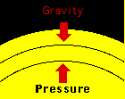
Key Concept: Gravity-Pressure balance
© Gerard Williger 2023 U Louisville
Sun in ``hydrostatic balance” between gravity pulling in and pressure from nuclear fusion in core pushing out

Slide 6
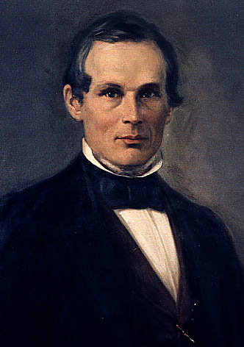
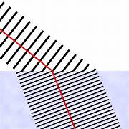
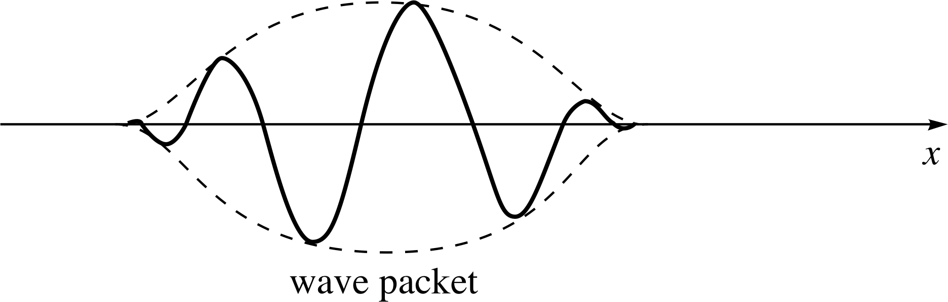
Key Concept -- Light: Wave-like AND Particle-like
Anders Ångström 1814-74
© Gerard Williger 2023 U Louisville
Electromagnetic WAVE-LIKE behavior:
Refracts (bends in air, water, glass etc.)
Diffracts (spreads out going through hole)
Wavelength measured in Ångstroms (Å, also in nm, microns, mm etc.); each wavelength has a frequency
1 Å= 10⁻¹⁰ m (m=meter), = 0.1 nm, X-ray wavelength
4000-7000 Å = optical wavelengths (what your eyes see)
bacteria-sized
-- PARTICLE-LIKE behavior (think billiard balls)
Is quantized (comes in distinct packets)
Light quantum (packet) = PHOTON
Photons have ENERGY, MOMENTUM, SPIN
So light can push on things
Unlike matter, photons have ZERO MASS
Wave packet
FYI 3’ VIDEO: what are electric and magnetic waves?

Slide 7
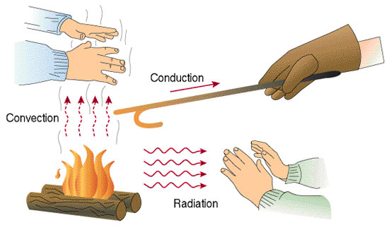
Key Concept: 3 Types Heat Transfer
© Gerard Williger 2023 U Louisville
1) Convection: moving blobs of hot material, ex. forced-air furnace moves warm air into room
2) Radiation: heating matter at a distance via high energy photons, ex. Warming your hands by a fire
3) Conduction: surface-to-surface contact between a warm and cold body, with heat transferred by molecular vibration, ex: warming your hands on a hot coffee cup

Slide 8
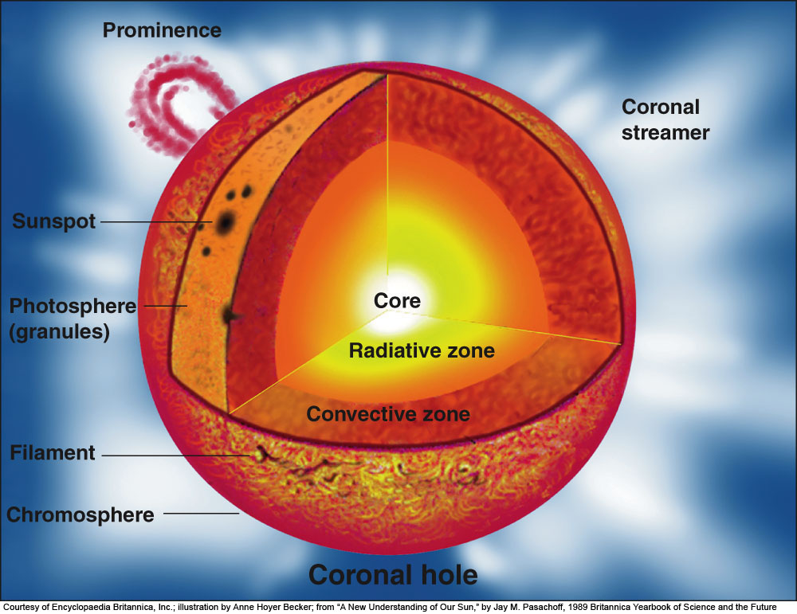
© Gerard Williger 2023 U Louisville
Notes:
Figure 10.3: The parts of the solar atmosphere and interior. The solar surface is depicted as it appears through a hydrogen filter; thus, here we actually see the chromosphere, except in the narrow sliver labeled “photosphere (granules).” The photosphere is the visible surface of the Sun.
The interior has a core, where the energy is generated, surrounded by a zone in which the dominant method of energy transfer is radiation and a zone in which convection (a “boiling” effect) dominates. On the surface, the photosphere, we find sunspots as well as loops of gas that are dark filaments when seen in projection against the disk and that are bright prominences when seen off the Sun’s edge. The chromosphere, a thin layer above the photosphere, shows best in hydrogen-light and is composed of small spikes known as spicules. The white corona above it extends far into space. Its shape, including its huge streamers, is determined by the Sun’s magnetic field. (Courtesy of Encyclopaedia Britannica, Inc.; illustration by Anne Hoyer Becker; from “A New Understanding of Our Sun,” by Jay M. Pasachoff, 1989 Britannica Yearbook of Science and the Future.)

Slide 9
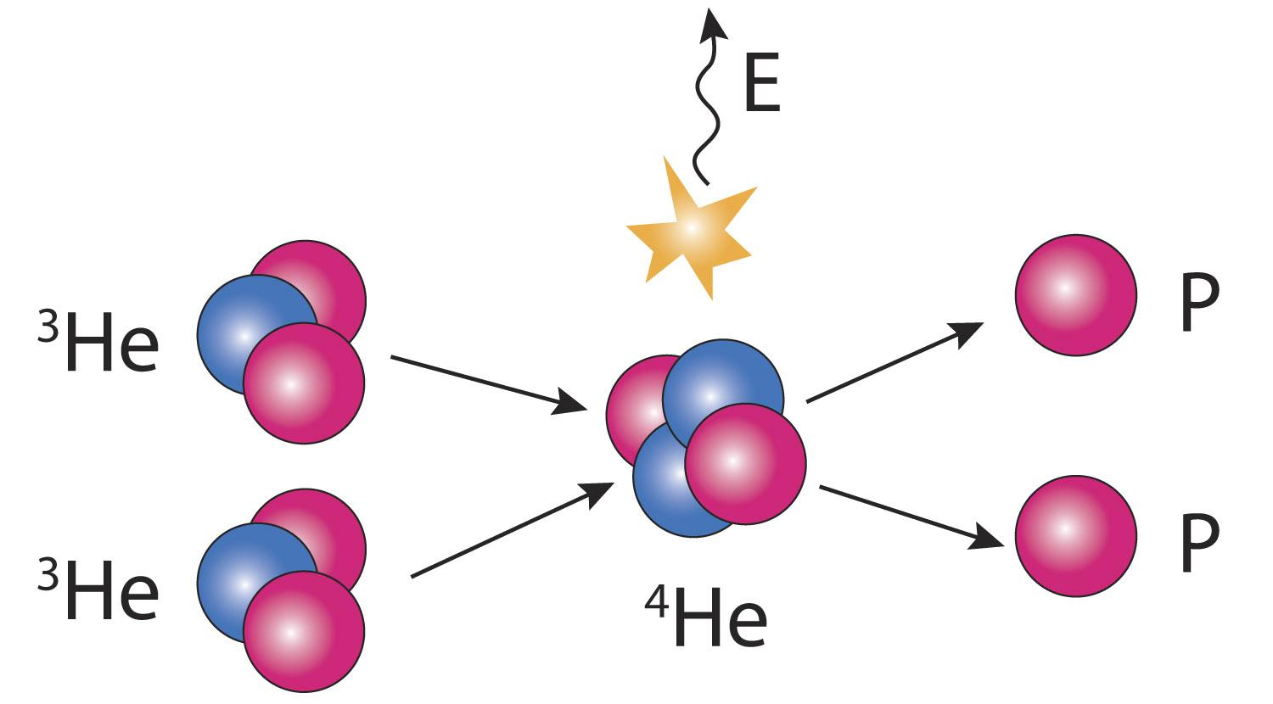

Solar Interior
© Gerard Williger 2023 U Louisville
Core: inner 25%, T~15 million Kelvin, pressure ~300 billion x Earth’s atmosphere, 14x denser than lead
Nuclear fusion: 4 hydrogens → 1 helium + energy
Radiative Zone: heat from core transferred by radiation; gas doesn’t move around
Convective Zone: Outer 30%, blobs of hot gas rise, cool gas sink to transfer heat to photosphere by convection
Fusion (last step)
Convec-tion

Slide 10
Convective Zone
© Gerard Williger 2023 U Louisville
In Sun’s core, atoms are so hot they’re ionized (no electrons)
→ don’t absorb photon energy easily. 85% of way out to “surface” from core, heavy element atoms (not hydrogen or helium, for example carbon) are cool enough to hold electrons
Heavy element held electrons absorb energy from high energy photons coming from core → heats the gas. It rises, cools, and sinks: convection

Slide 11
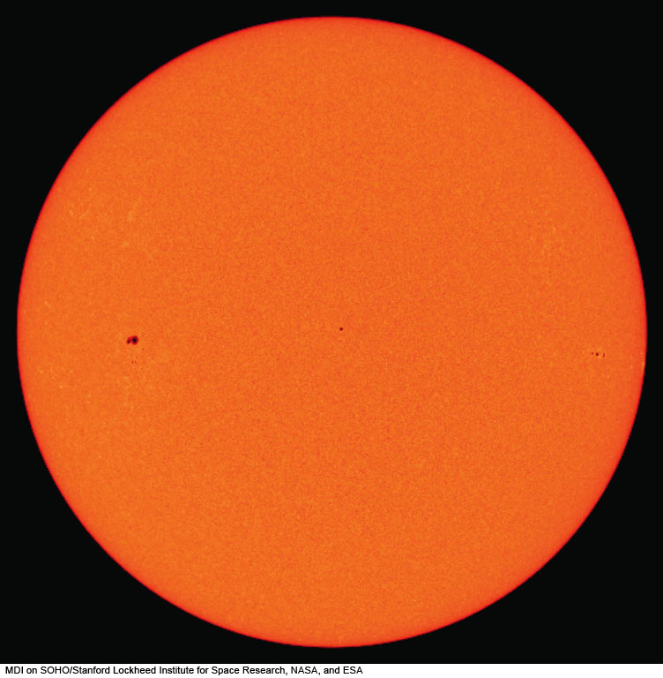
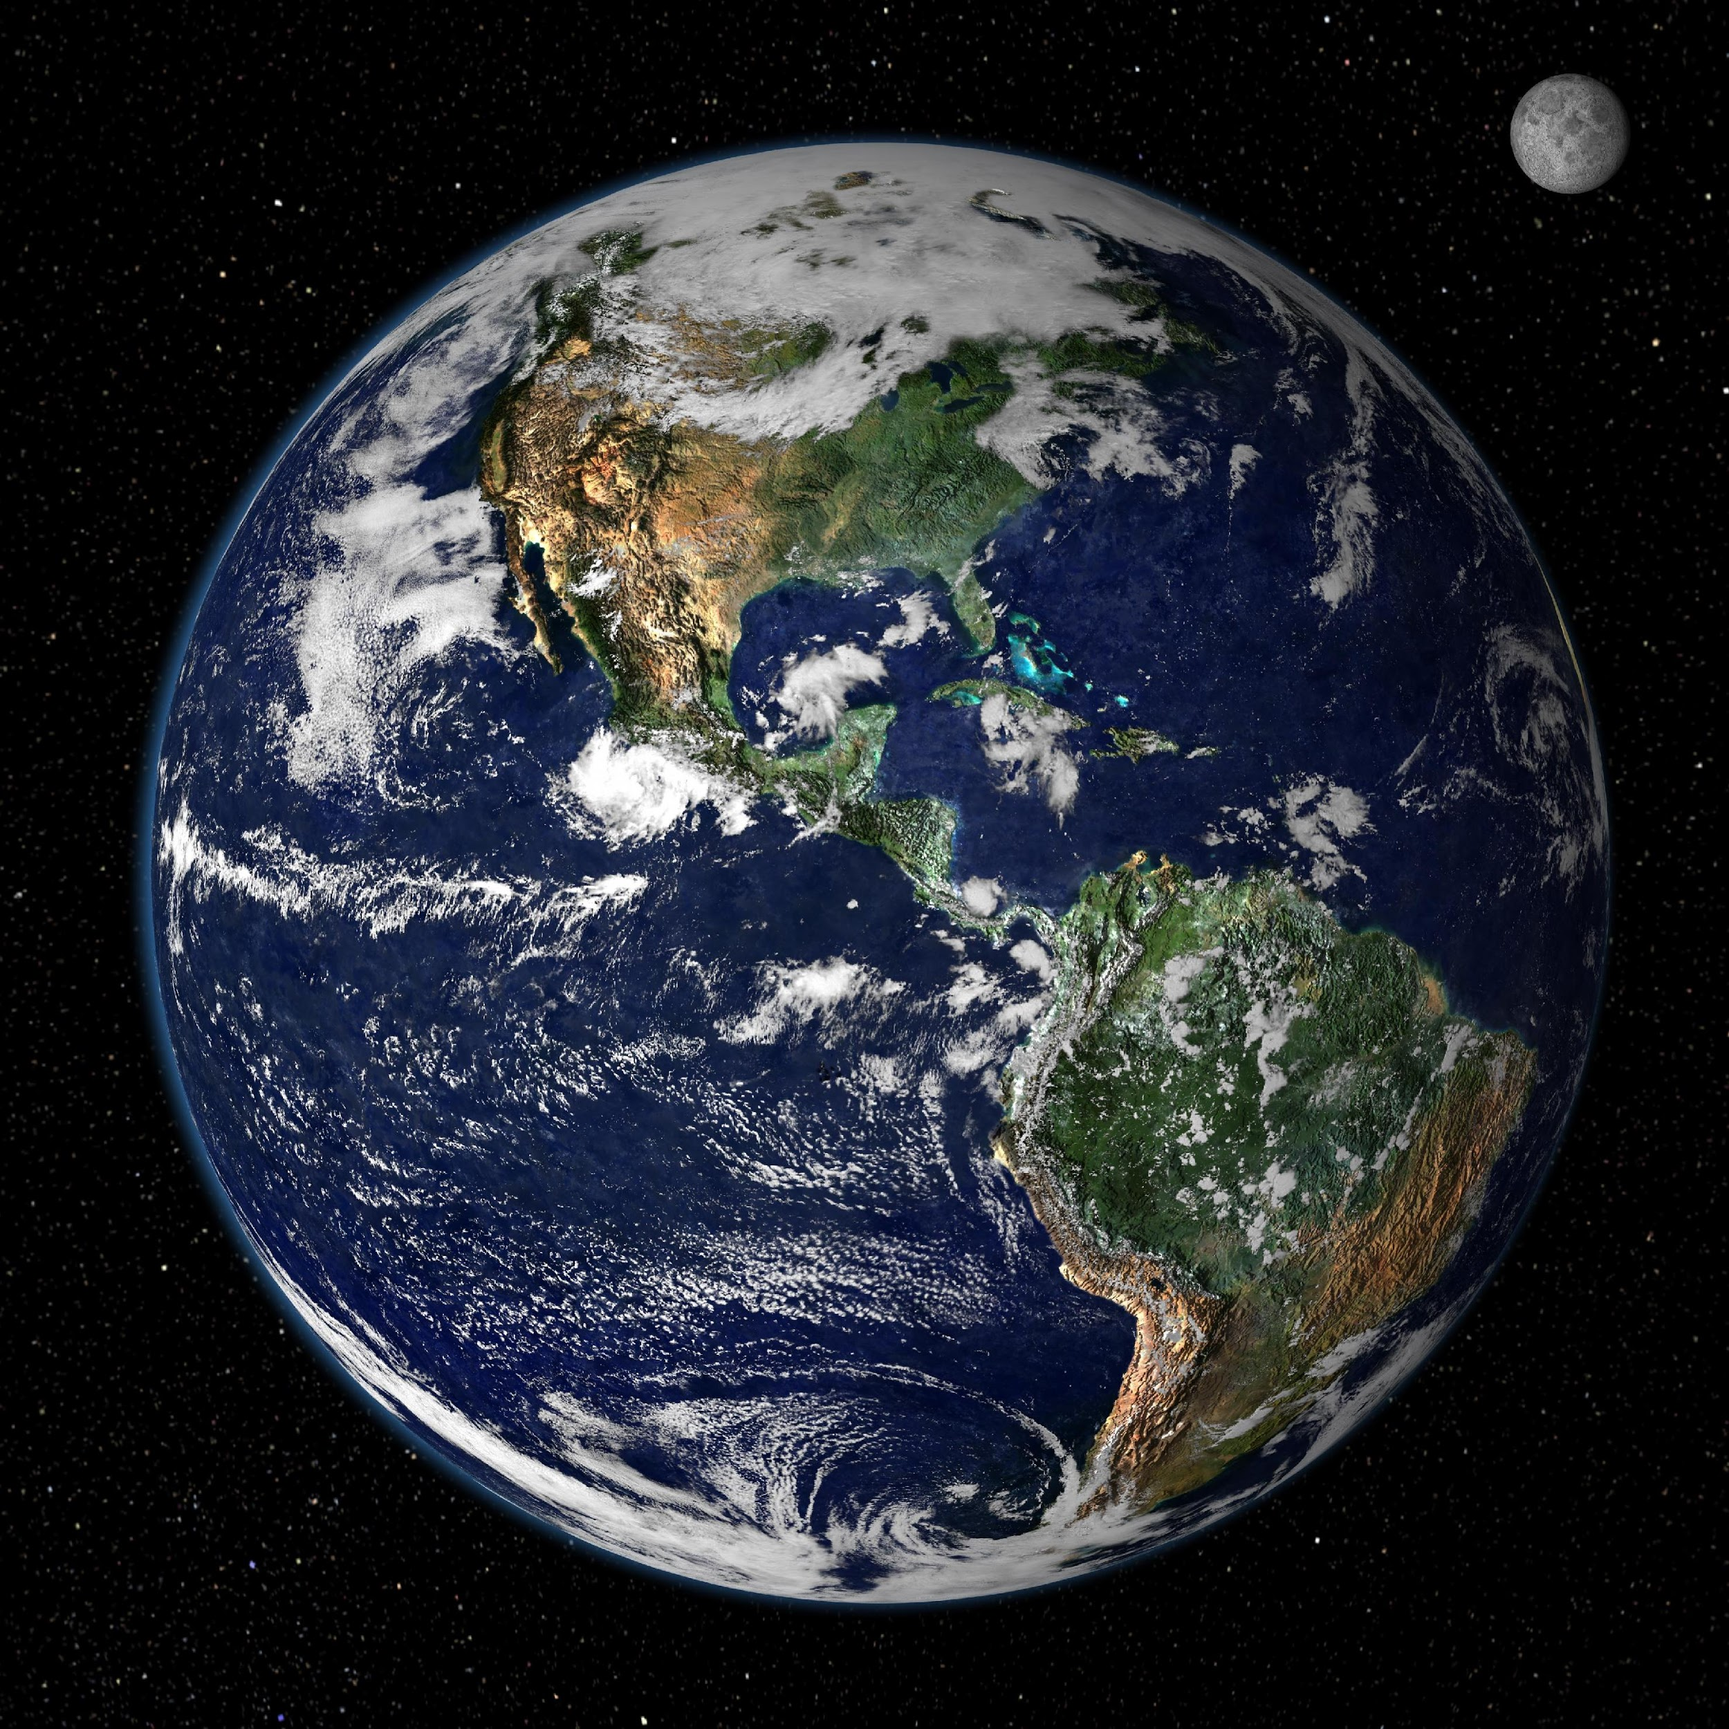
5.1 Photosphere
© Gerard Williger 2023 U Louisville
Diameter: ~110x Earth
Slightly oblate/flattened due to rotation
Shows dark sunspots (more later)
Earth
Notes:
Figure 10.2: The solar photosphere in an image taken on April 8, 2005, the day of a total eclipse.
MDI on SOHO/Stanford Lockheed Institute for Space Research, NASA, and ESA

Slide 12
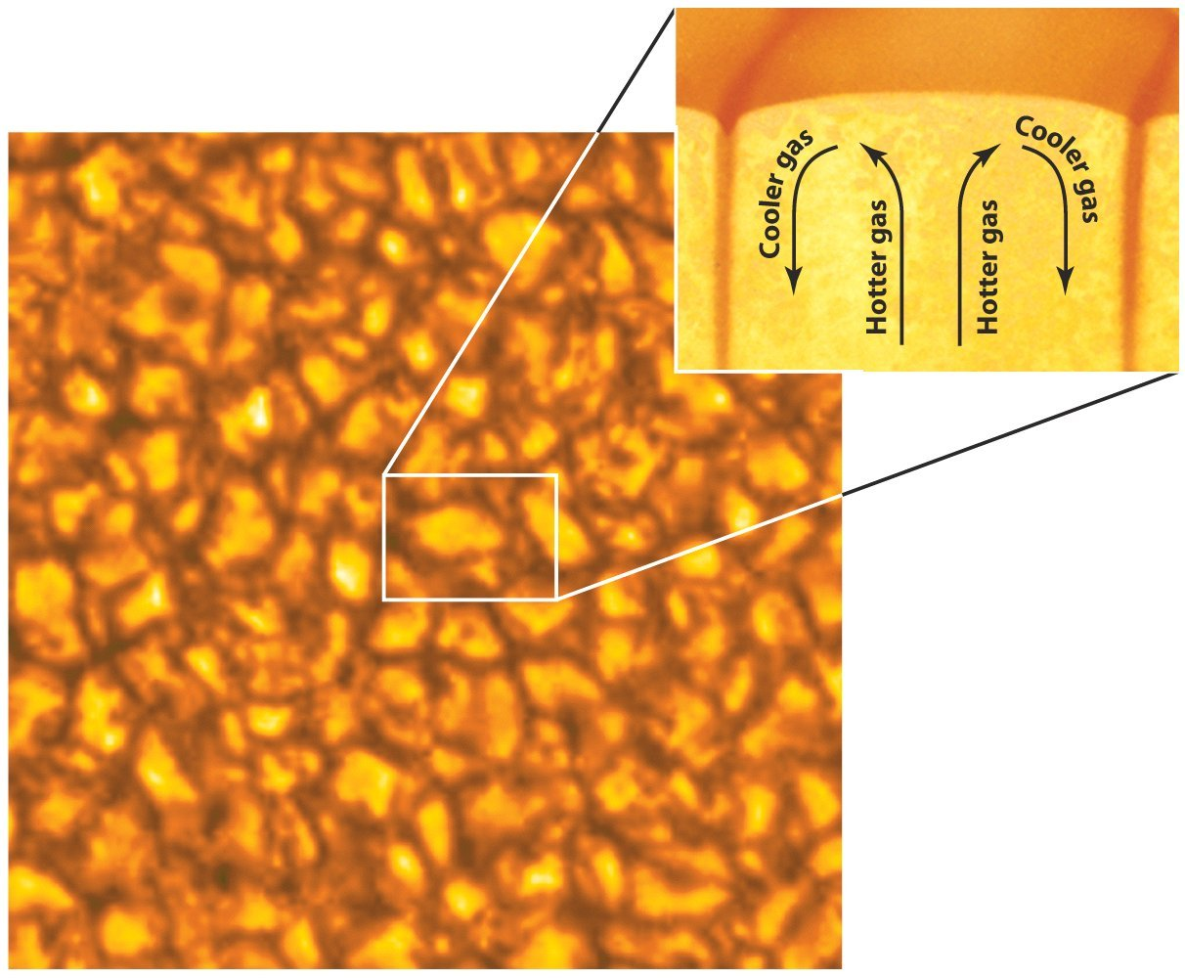
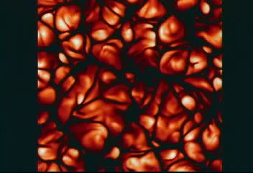
Photosphere - Details
© Gerard Williger 2023 U Louisville
Deepest we can see into Sun
deeper is opaque
No solid surface
T~5800K = 10,000F (on average)
Gives off light of all colors
Mostly yellow light, appears yellow-white to eyes
Shows “granules” (convection cells rising, cooling then sinking)

Slide 13
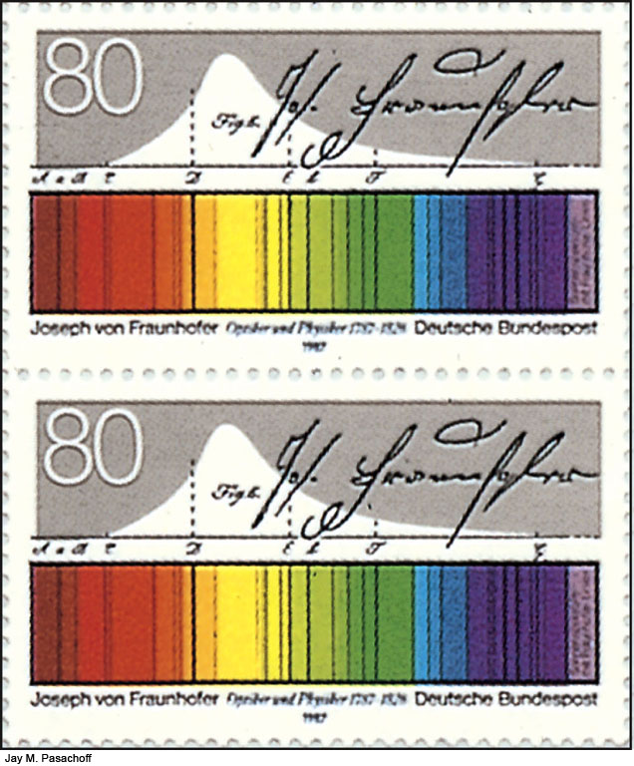
Photosphere Spectrum
© Gerard Williger 2023 U Louisville
Continuum blackbody source (all wavelengths of light)
+Many absorption lines (Fraunhofer lines)
Lines from many elements: H,He,Ca,Fe,Na etc.

Slide 14
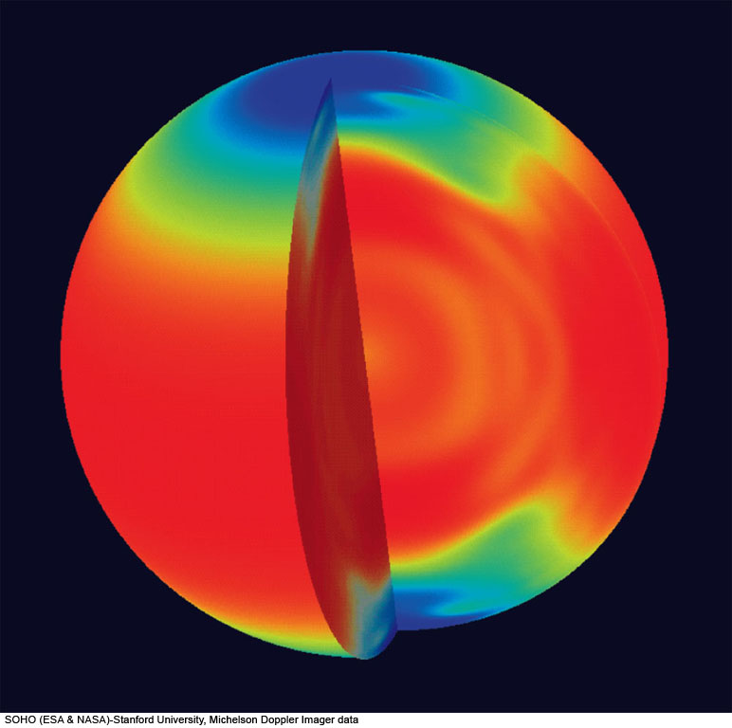
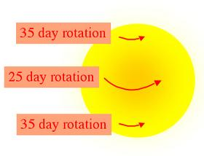
Solar Rotation
from Helioseismology (Doppler shifts) and sunspots
Photosphere+Convective Zone: Differential rotation
25 days @equator, 35 days @poles
Twists up magnetic fields → solar `dynamo’
© Gerard Williger 2023 U Louisville
Notes:
Figure 10.6: The rotation periods of different layers and regions of the Sun, based on helioseismology results, shown in false color. Measurements reveal that the surface rotation periods, which vary from 26 days at the equator to 36 days at the poles, persist inward through the solar convection zone. Further toward the center, the data show that the Sun rotates as a solid body with a 27-day period.
SOHO (ESA & NASA)-Stanford University, Michelson Doppler Imager data

Slide 15
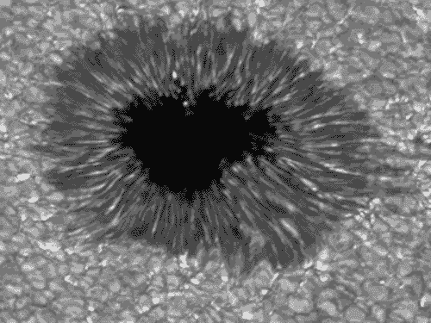
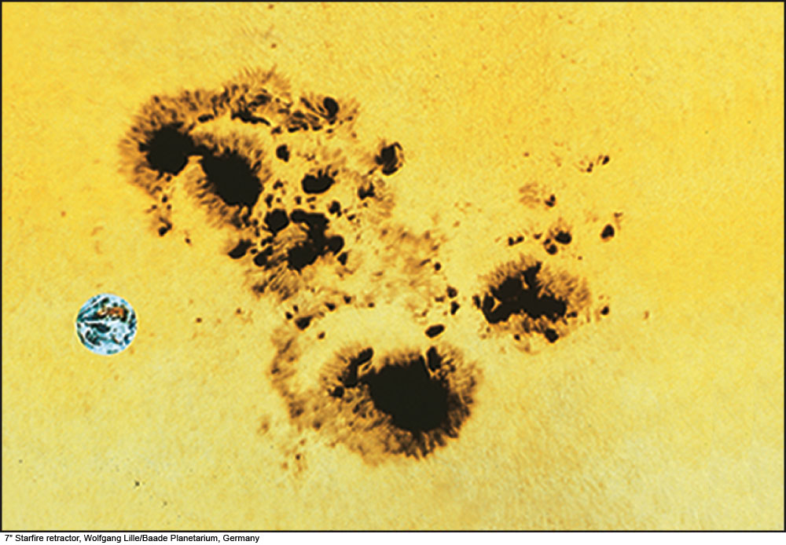
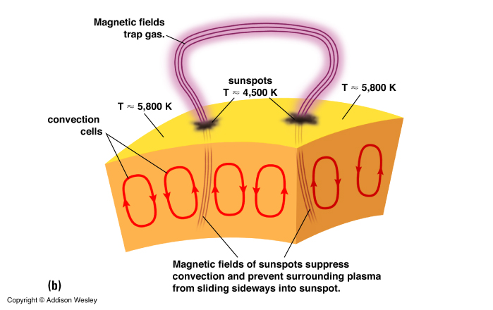
© Gerard Williger 2023 U Louisville
5.2a Sunspots
Earth
Umbra
Penumbra
Magnetic fields of sunspots suppress convection → hot gas (plasma) just stays in place and cools -- DOES NOT SINK
Notes:
Figure 10.16: A sunspot group, showing the dark umbra surrounded by the lighter penumbra for different spots in the group. A photo of the Earth is superimposed to show its relative size.
7” Starfire retractor, Wolfgang Lille/Baade Planetarium, Germany

Slide 16
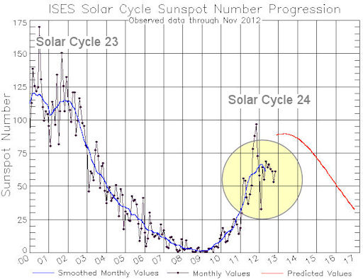
Sunspots
© Gerard Williger 2023 U Louisville
Publicized by Galileo; observed by Chinese before telescopes
T~3800K (cool!) so appear DARK against Sun
Can last for >1 month, occur in groups
Appear where magnetic field is STRONG
>~10,000x stronger around Sunspots than Earth’s mag field (or ~10x average for Sun)
Occur in pairs: north and south magnetic polarity

Slide 17
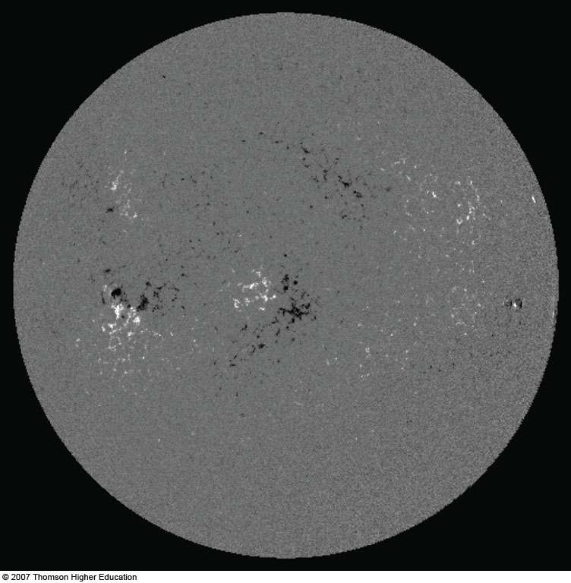
Magnetic Field of the Sun
© Gerard Williger 2023 U Louisville
Opposite magnetic polarities
Notes:
Figure 10.17b: The magnetic field of the Sun on April 8, 2005, the day of an eclipse, to match earlier solar images in this chapter. Black and white, respectively, show opposite polarities. Compare with the sunspot diagram of Figure 10-2.

Slide 18
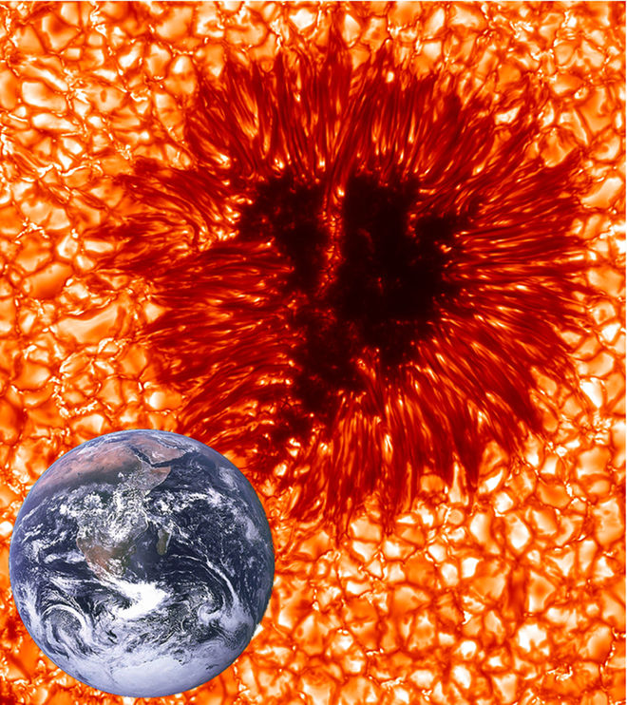
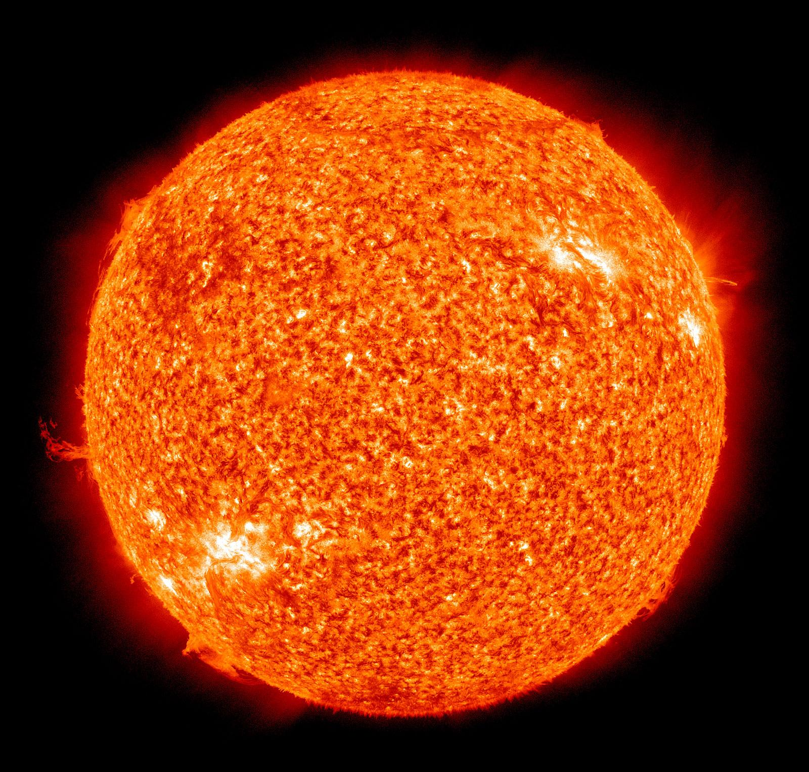
How Sunspots Work
© Gerard Williger 2023 U Louisville
Charged particles (all of Sun) move along magnetic field lines
Strong mag field lines keep hot material from coming up from solar interior
Sunspot areas radiate away heat, cool off
Stay @same latitude where `born’, rotate with Sun
Reach maximum numbers every 11 years
Related to twisting of mag fields over time
Mag polarity reverses after 11 yrs; whole cycle 22 yrs
Next maximum 2023-2024 – during eclipse!
Sun gets ~0.1-0.2% brighter during sunspot max! (Reason: many little bright areas called faculae in photosphere more than make up for sunspots.)
NASA-SOHO

Slide 19
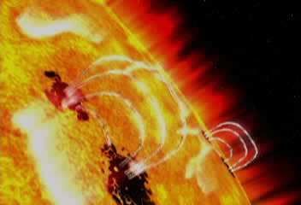
Sunspot Formation & Flare
© Gerard Williger 2023 U Louisville

